Slide 1
Network Communication and Types

Slide 2
Session Objectives
After going through this session you will be able to understand
Data Communication
Components of Data Communication
Type of Communication
Network Definition and Classification
Notes:
1.#

Slide 3
Introduction
A computer network is an interconnection of computers.
It uses a set of common communication protocols.
Used for sharing resources located on the network nodes.
The interconnections between nodes are formed from a broad spectrum of telecommunication network technologies.
The nodes of a computer network may be classified by many means as personal computers, servers, networking hardware, or general purpose hosts.
They are identified by hostnames and network addresses.
Notes:
1.#

Slide 4
Data Communication
The term telecommunication means communication at a distance.
The word data refers to information presented in whatever form is agreed upon by the parties creating and using the data.
Data communications are the exchange of data between two devices via some form of transmission medium such as a wire cable.
Notes:
1.#

Slide 5
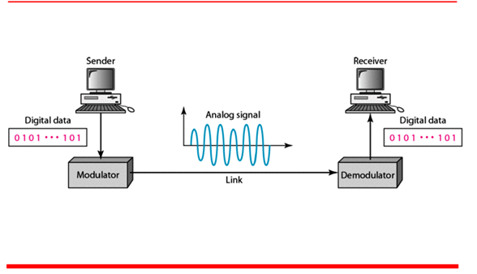
Figure 1 Five components of data communication
Sender
Receiver
Protocol
Medium
Messages
Notes:
1.#

Slide 6
Data Representation and Flow Method
Data is represented in the following formats text, numbers, images, audio, and video.
Communication between two devices can be simplex, half-duplex, or full-duplex as shown in Figure 2.
Notes:
1.#

Slide 7

Figure 2 Data flow (simplex, half-duplex, and full-duplex)
Notes:
1.#

Slide 8
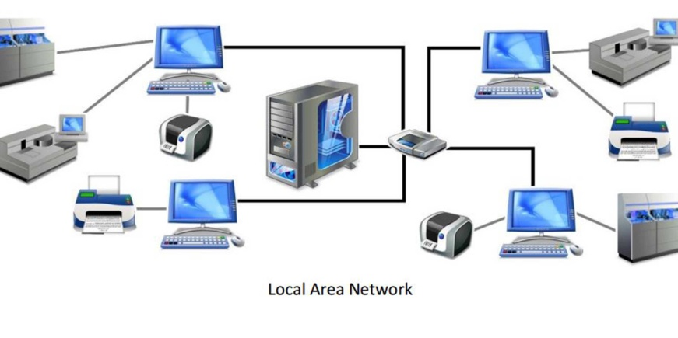
Network Definition
A network is the interconnection of a set of devices capable of communication.
A device can be a host such as a large computer, desktop, laptop, workstation, cellular phone, or security system.
A device in this definition can also be a connecting device such as a router a switch, a modem that changes the form of data, and so on.
A network must be able to meet a certain number of criteria such as performance, reliability, and security.
Notes:
1.#

Slide 9
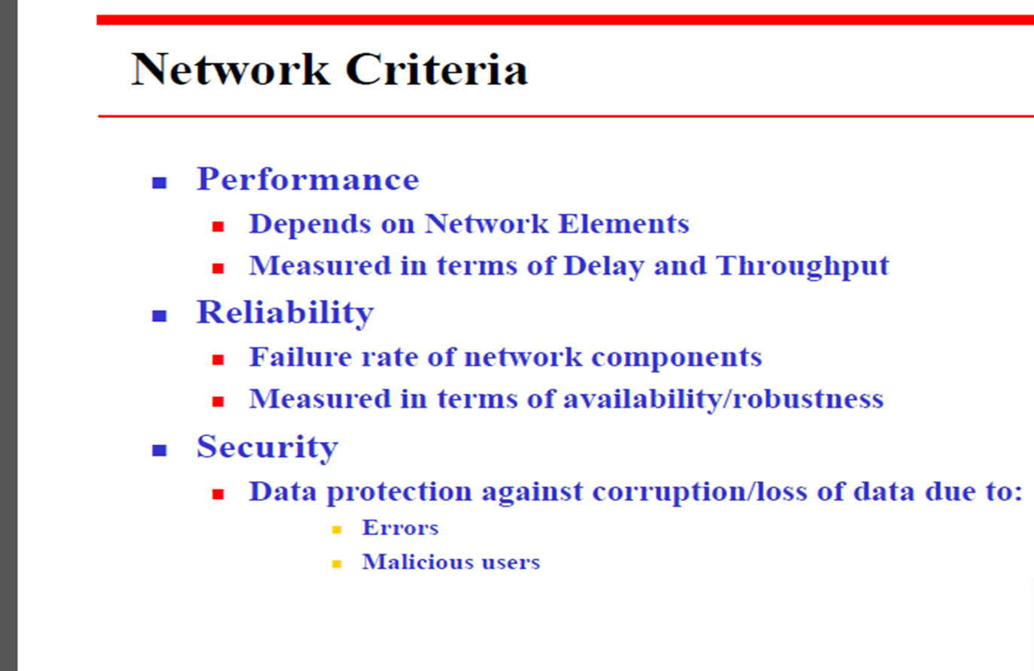

Slide 10

Figure 3 Types of connections: point-to-point and multipoint
Notes:
1.#

Slide 11
Network Classification
The criteria of distinguishing one type of network from another is based on few criteria such as size, geographical coverage, and ownership to make this distinction.
They are classified as:
  Local Area Networks (LANs)
  Wide Area Networks (WANs)
  Metropolitan Area Networks (MANs)
  Storage Area Networks (SAN)
  Personal Area Networks (PAN)
Notes:
1.#

Slide 12
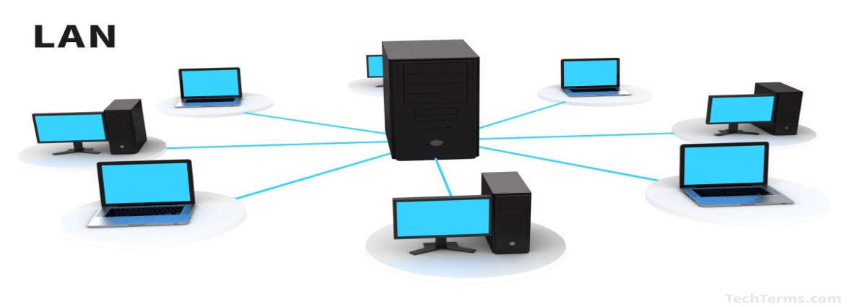
Local Area Networks (LANs)
A LAN is a group of computer and peripheral devices like hard-disks, DVD-ROM, and printers.
Work in limited area such as school, laboratory, home, and office building.
Useful for sharing resources like files, printers, games, and other application.
It is a private network.
LAN operates at a relatively higher speed and follow standard of 802.3
There are various kinds of media access control methods like token ring and Ethernet.
Notes:
1.#

Slide 13
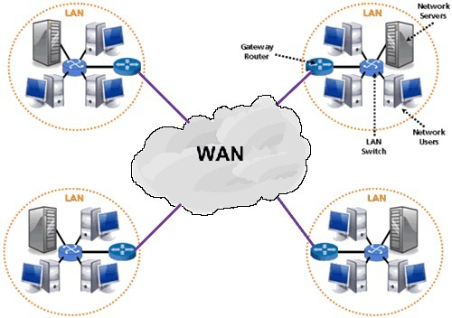
Wide Area Networks (WANs)
WAN is spread across a large geographical area.
WAN network system could be a connection of LANs or MANs.
The LANs are interconnected using telephone lines and radio waves.
The software is shared among all the users and all can access them.
Any organization can form its global integrated network using WAN.
It follows network standard as 802.11, 802.1, 802.3
Notes:
1.#

Slide 14
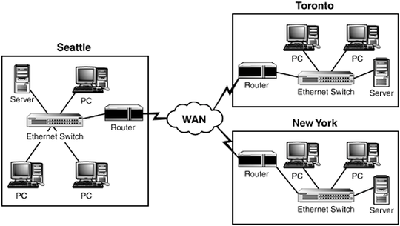
Metropolitan Area Networks (MANs)
Consist of a computer network across an entire city, college campus, or a small region.
Mostly used medium for communication is optical fibers cables.
Data rates adequate for distributed computing applications.
MAN network uses dual bus for both directions communication.
It follows network standard as 802.11, 802.1, 802.3
Notes:
1.#

Slide 15
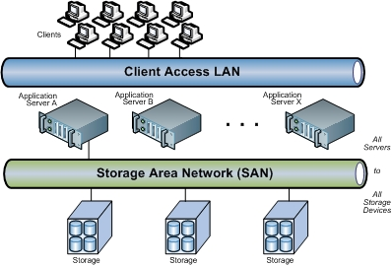
Storage Area Networks (SANs)
    A SAN is a specialized, high-speed network access to storage devices.
    SANs are typically composed of hosts, switches, storage elements, and storage devices that are interconnected using a variety of technologies, topologies, and protocols.
    It uses virtualization to make storage available to every host connected.
Notes:
1.#

Slide 16
The SAN interconnects all the disks into a dedicated storage area network.
That dedicated network exists separate and apart from the common LAN.
This approach enables any of the servers connected to the SAN to access any of the disks attached to the SAN, effectively treating storage as a single collective resource.
None of the SAN storage data needs to pass across the LAN -- mitigating LAN bandwidth needs and preserving LAN performance.
SAN is a separate dedicated network, the network can be designed to emphasize performance and resilience, which are beneficial to enterprise applications

Slide 17
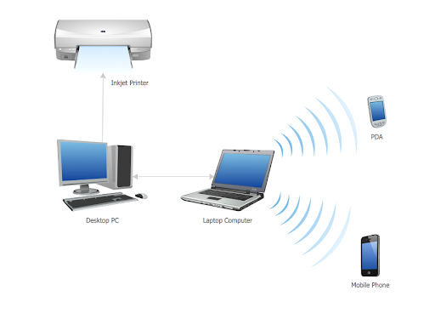
Personal Area Networks (PANs)
PANs are short-range wireless networks that work over a range of tens of metres.
PANs main role is to eliminate cables that connect our devices to peripherals.
The devices are cordless products, such as mouse devices and keyboards, that use radio or infrared.
Mode of communication is generally Bluetooth, which allows enabled devices such as phones, mobiles, mouse devices, headsets, PCs, printers and keyboards to connect wirelessly.
Notes:
1.#

Slide 18
Summary
In this section we have discussed the following:
Data Communication
Communication types, simplex, half-duplex and full-duplex
Computer network definition
Type of computer networks.
Notes:
1.#

Slide 19

Notes:
1.#

